Slide 1
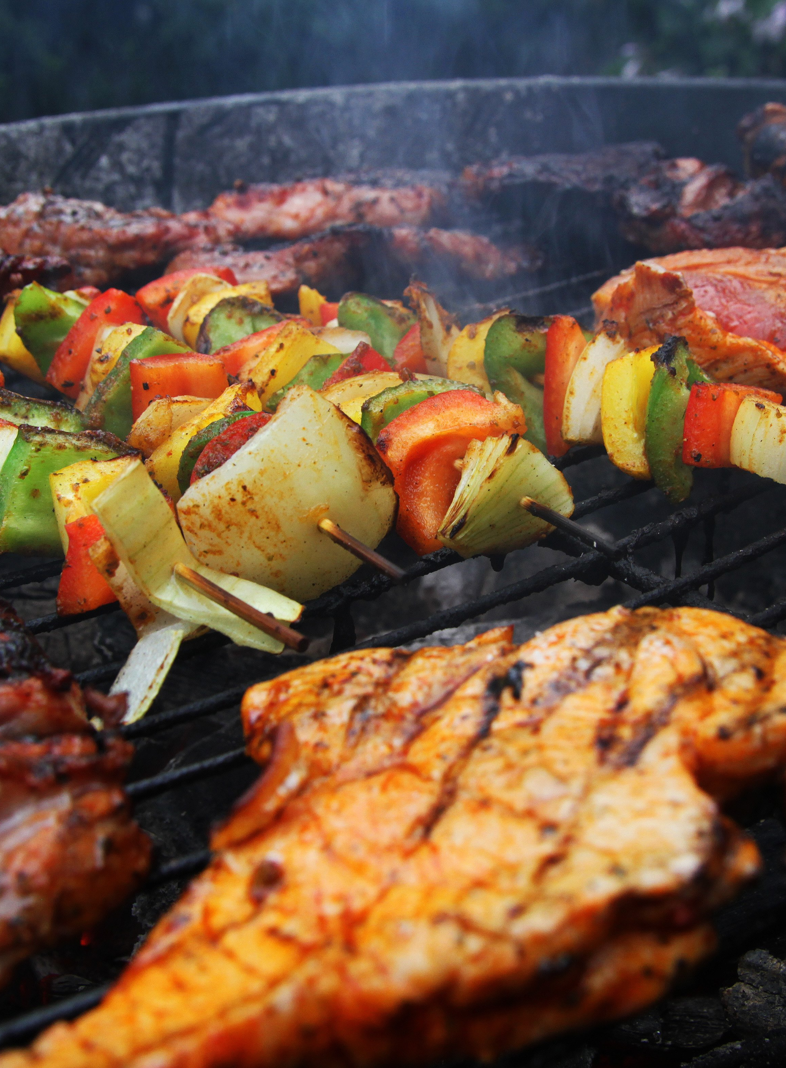

Food4YOU
Zahoor Ali
Manish Thakur
Vasudha Warwatkar
Shivani Kashamolla
Sumanth Reddy

Slide 2
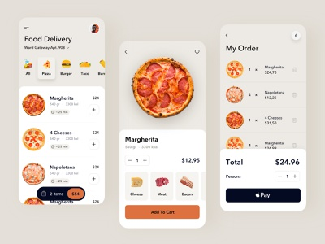
View List Of ITEMS
Add ITEMS To Cart
USER
Search a Book
Search a ITEM
Order ITEM
AND Payment
PASSWORD SETTINGS
PASSWORD SETTINGS

Slide 3
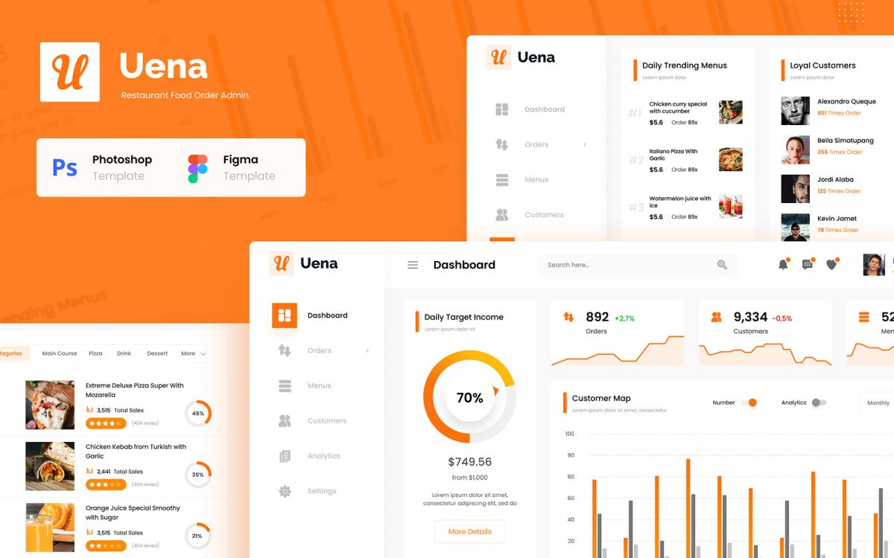
ADMIN Operations
ADD New Items
UPDATE Items
VIEW List Of Items
Manages the Categories Section
Manages the Products Section
DELETE Items

Slide 4





TECHNOLOGIES

Slide 5
DOCKER
DEPLOYEMENT TOOLS
AWS
HEROKU

Slide 6




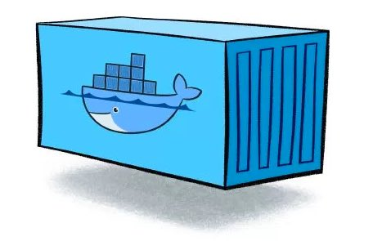
DOCKERIZATION
Docker Hub
Docker File
Commit
and Push
Add
Run
Code
Build
Docker image
Docker Container

Slide 7
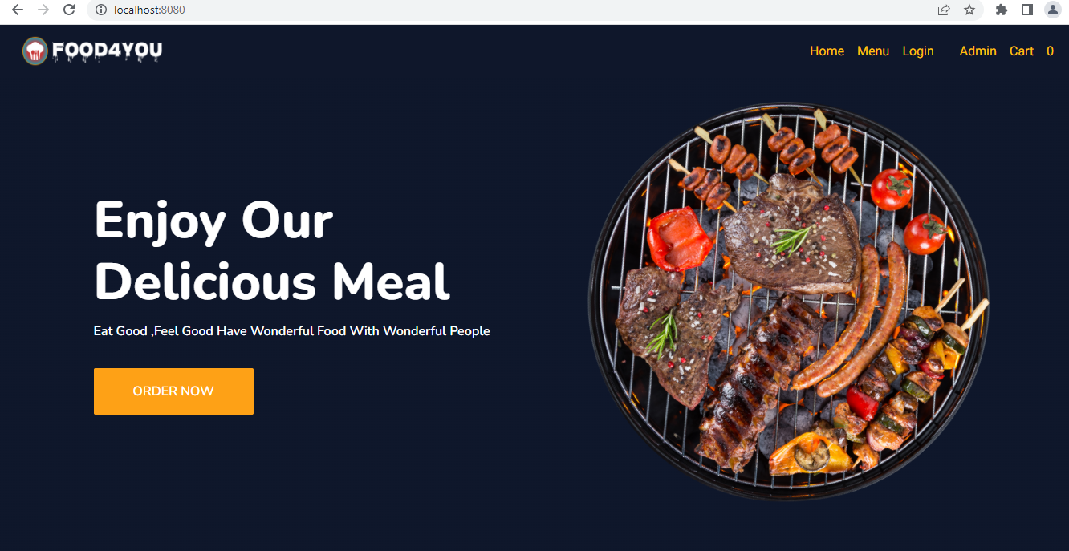
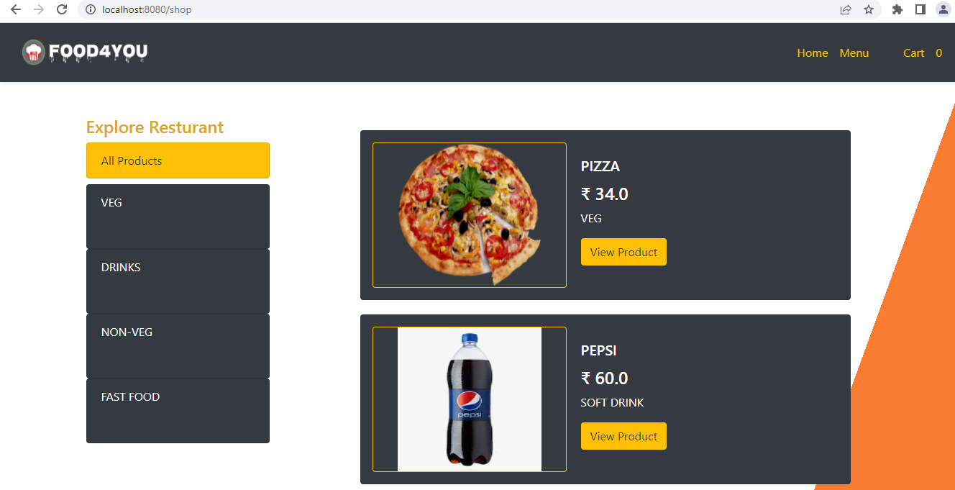
Home Page
Menu Page

Slide 8
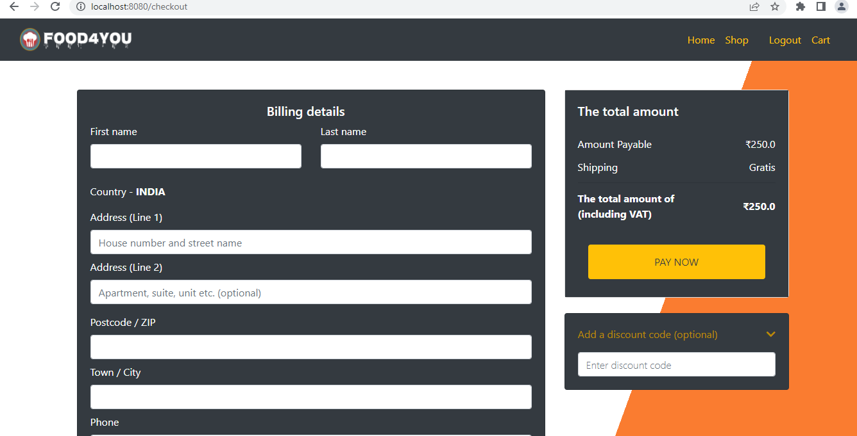
Payment Page

Slide 9
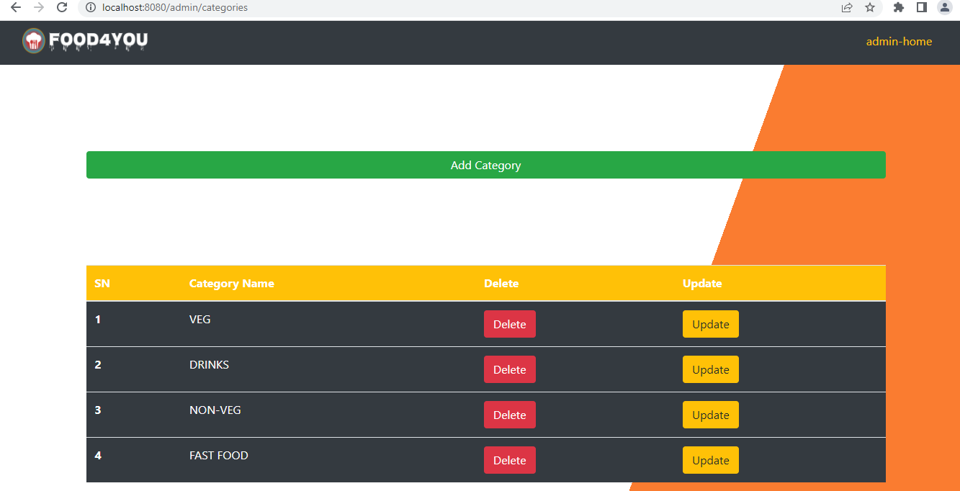
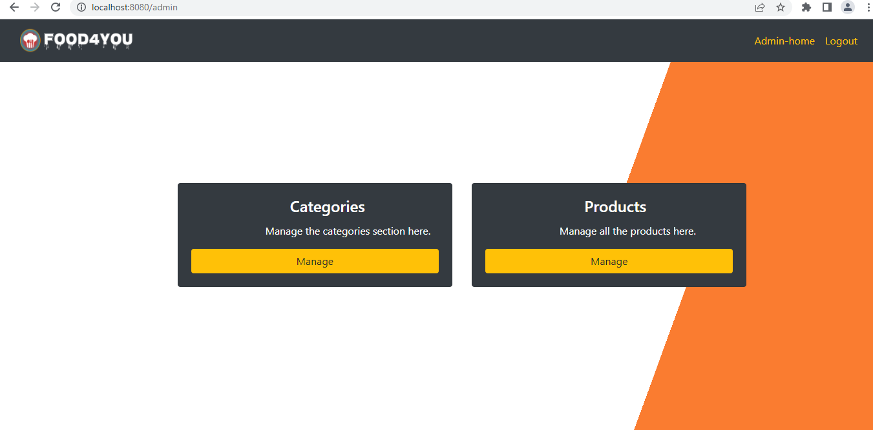
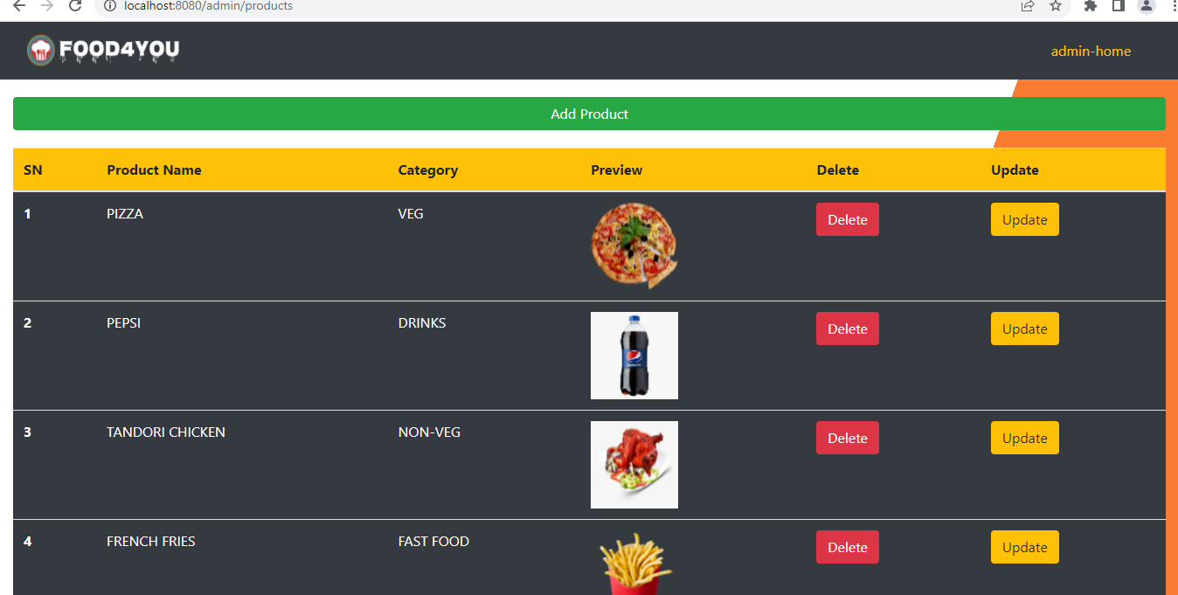
Categories
Admin Page
Products

Slide 10
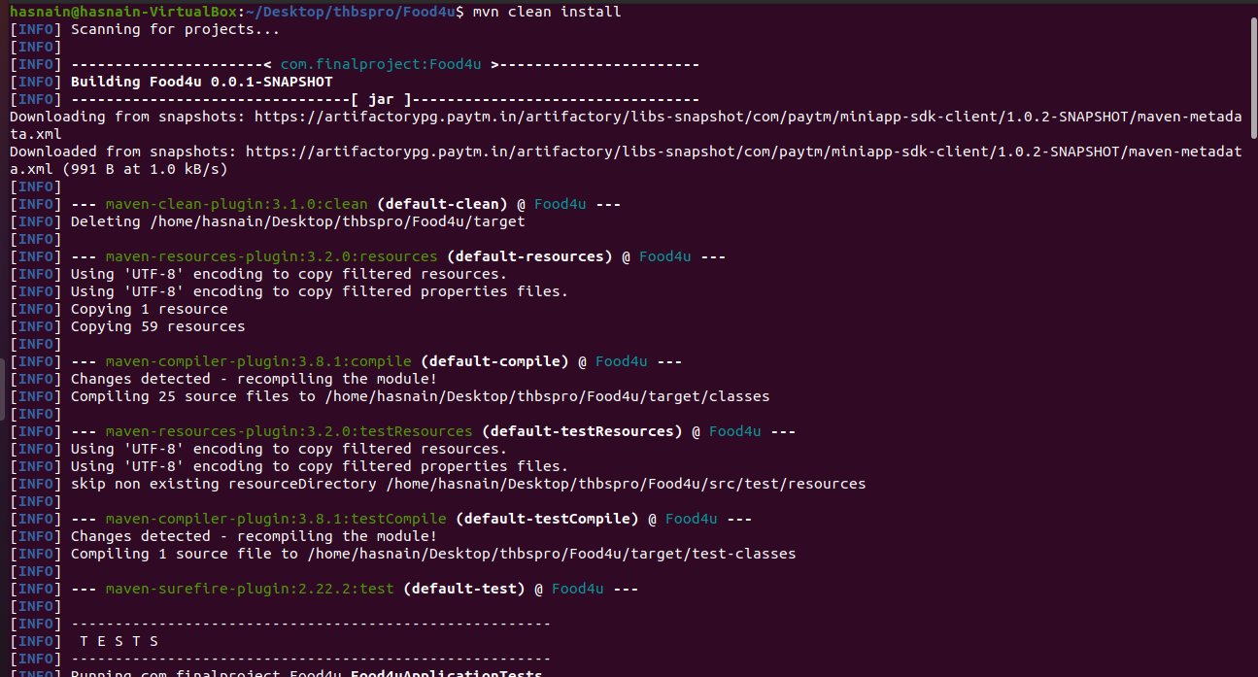
Docker File

Slide 11
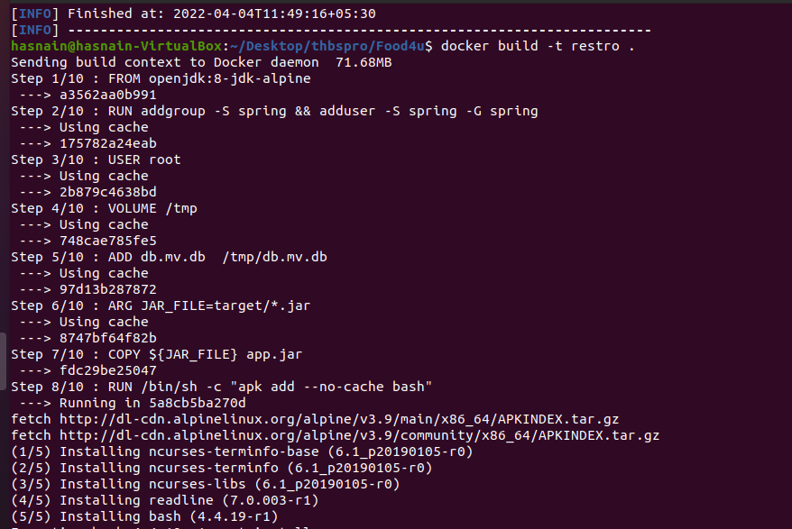

Slide 12
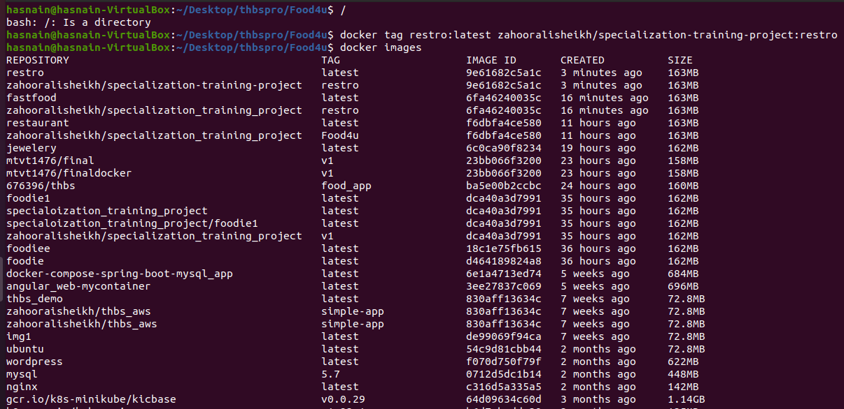
Created Docker Image

Slide 13
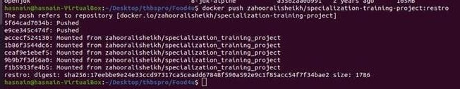
Pushing image to Docker Hub

Slide 14
Thank you

